Slide 1
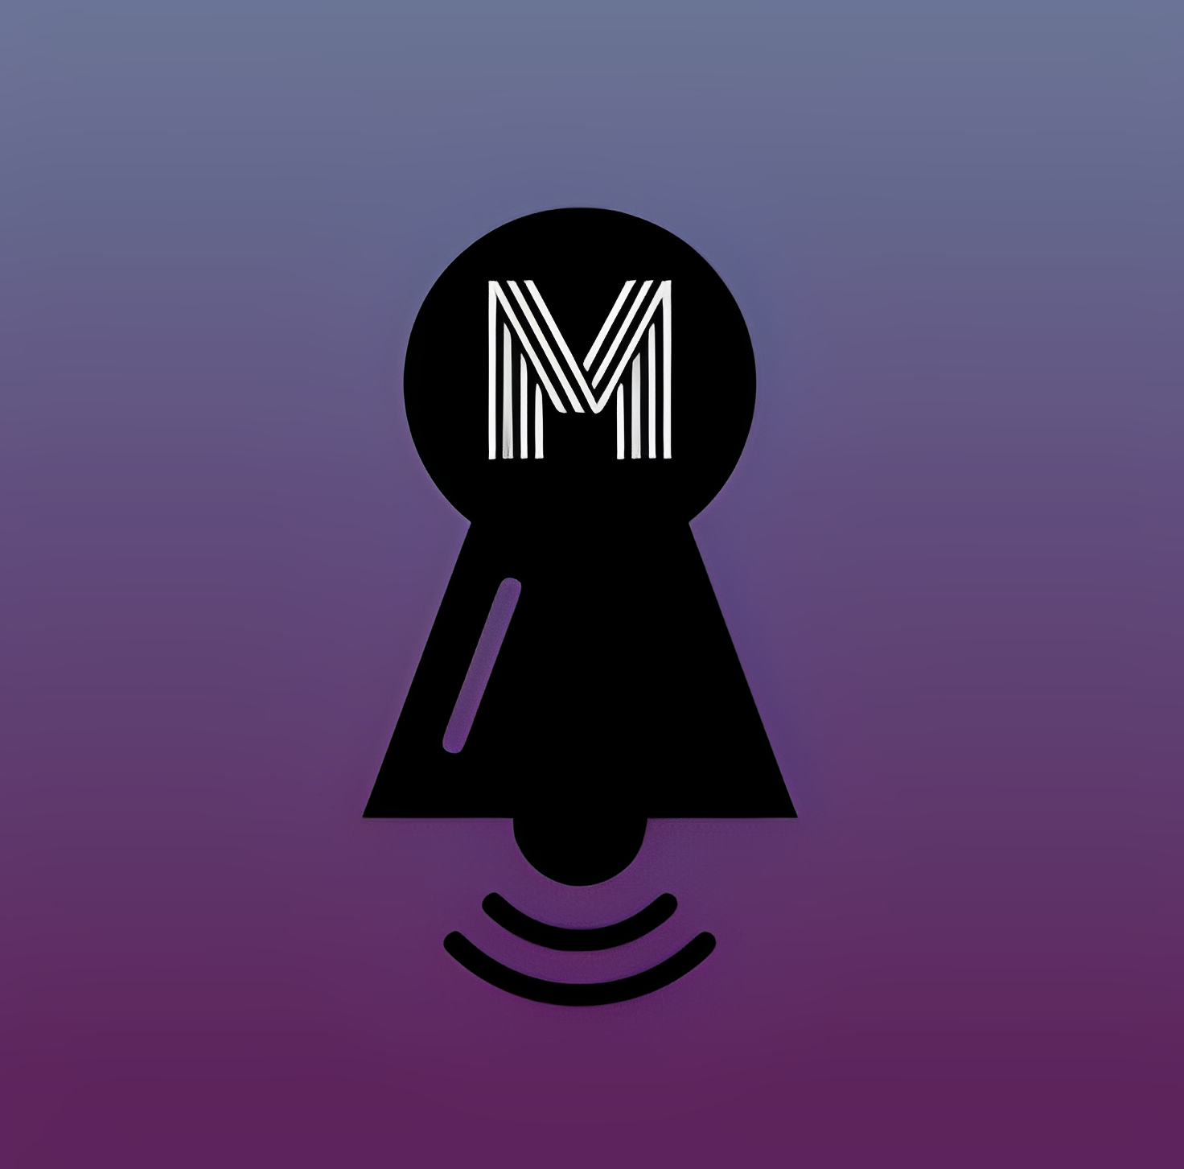
Final Project Presentation
MUFFLE
CS5600 - Computer Networks
Department of Computer Science
Ethan Moore
Pavan Raj Dasari
Sai Ganesh Pamarti

Slide 2
What is Muffle?
Muffle is a chat application for Web, Android, IOS, Windows, and Mac.
Has a uniquely customizable notification setting
Set who you will be notified by, when
Send automated replies in Do Not Disturb mode
Allow some people to override Do Not Disturb mode

Slide 3
Motives
People often get disturbed by the messages?
Want to ignore work during freetime.
But it’s to get interrupted by some of the people in any situation?
Example a message from your parent.
You might be doing some important work and prefer no distractions?
Yes, we do have priorities set.

Slide 4
Working Model:
Msg sent by sender
Msg received
Yes
DND ON
No
If the contact is in Notify anyway list
Yes
Notification sent
No
Automatic msg

Slide 5
Technologies Used
Messaging
Originally intended to use Project Tox
Now Using Firebase
Client Program
Using Flutter to create once and ship to multiple platforms
Database
Firebase Cloud Storage
Authentication
Google gmail sign-in

Slide 6
Technologies Used
Front end | Flutter
Back end | Firebase
Architecture | Client - Server

Slide 7
Individual contribution
Ethan Moore: Research and proof-of-concept prototypes (33%)
Pavan Raj Dasari: end-to-end coding (34%)
Sai Ganesh Pamarti: testing, prototyping and coding (33%)

Slide 8
Demo

Slide 9
References
https://flutter.dev/
https://firebase.google.com/
https://github.com/duytq94/flutter-chat-demo
https://github.com/DevStack06/Whatsapp-Clone-Flutter

Slide 10

Questions?

